Slide 1
Characterization of mmWave Reflecting Surfaces for Rapid Intelligent Cellular Coverage Enhancements
Master Thesis Kickoff Presentation
Padmashree Reddy
Supervisor: Mr. Simon Häger
21. July 2023
Notes:
The purpose of today’s presentation is to provide a brief overview of my thesis topic and outline the key objectives that I will be exploring in the coming months

Slide 2
Outline
Introduction
Related Work
Methodology and Implementation
Results and Conclusion
Timeline
Notes:
Before entering into the details, I would like to provide you with an overview of my research and the key aspects that will be covered in this presentation.
In introduction, we lay a foundation for our study by highlighting few important aspects.
We explore the related work in this field, which will provide valuable insights and then delve into our own methodologies and implementations, where we outline the steps and techniques employed in our study.
We gather valuable data from multiple simulations using Ansys HFSS and Matlab and be able to draw meaningful conclusions based on the outcomes.
Finally, we lay a timeline on the next steps on how we approach to achieve the research.

Slide 3





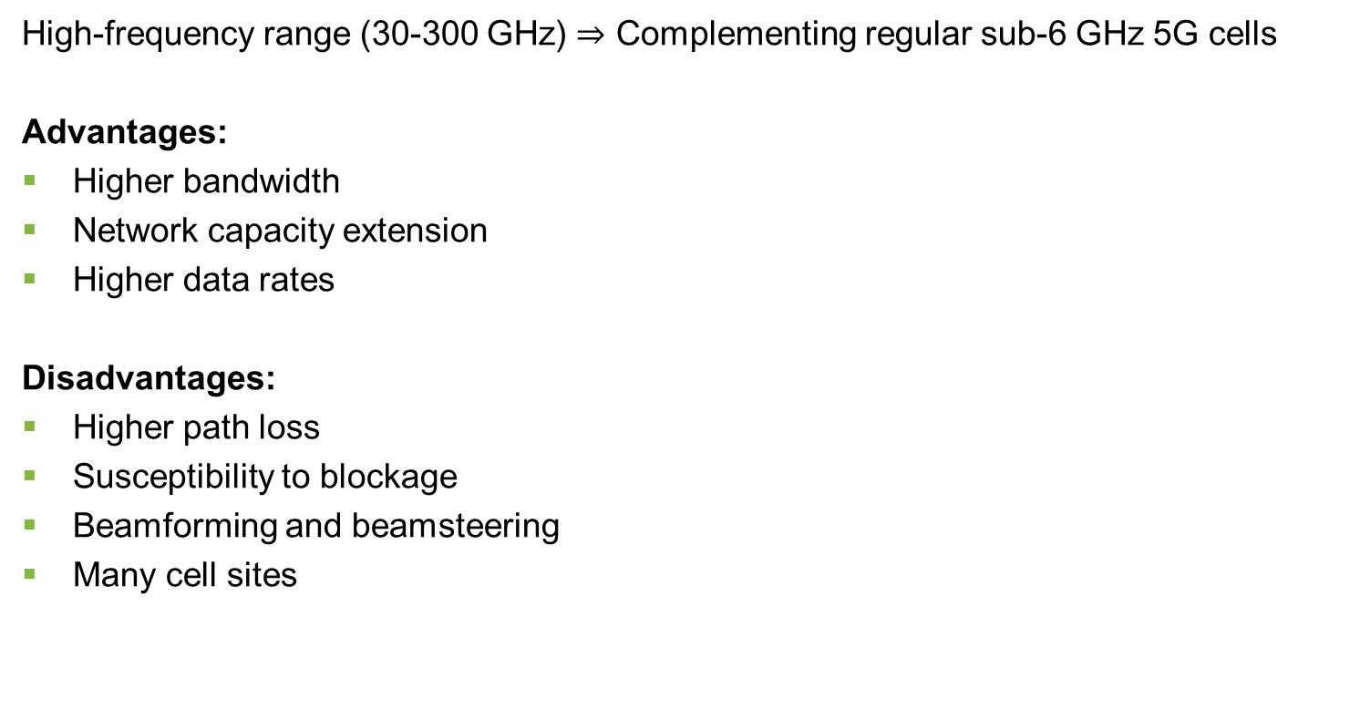
1. Introduction: Millimeter-Wave (mmWave) Communication
BS: Base Station
V2X: Vehicle-to-Everything
High-frequency range (30-300 GHz) $⇒$ Complementing regular sub-6 GHz 5G cells
Advantages:
Higher bandwidth
Network capacity extension
Higher data rates
Disadvantages:
Higher path loss
Susceptibility to blockage
Beamforming and beamsteering
Many cell sites
Creates hot spots for communication
Macro cell BS
Ultra-dense small cells
Sub-6 GHz
Smart grid
Future
applications
Micro cell BS
Micro cell BS
5G (> 6 GHz)
V2X
Fig.1: Illustration of typical deployment of mmWave communications with use cases [1, 2].
Solution: Reflectors to improve mmWave communication
[1] W. Hong et al., "The Role of Millimeter-Wave Technologies in 5G/6G Wireless Communications," in IEEE Journal of Microwaves, vol. 1, no. 1, pp. 101-122, Jan. 2021, doi: 10.1109/JMW.2020.3035541.
[2] K. Sakaguchi et al. “Where, When, and How mmWave is Used in 5G and Beyond.” IEICE Trans. Electron. 100-C (2017): 790-808.
Notes:
High bandwidth to satisfy the increase demand of user with all the new technologies.

Slide 4
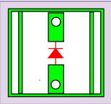




1. Introduction: Intelligent Reflecting Surface (IRS)
BS: Base Station
Buildings with IRS
Advantages:
Enhanced signal coverage and quality
Flexibility and adaptability
Privacy and security
Reduced interference
Disadvantages:
Synchronization and coordination
Complexity and cost
BS
X
X
X
BS
X
Eavesdropper
User
BS
Legitimate receiver
Dead zone user
Control board
Copper plate
Array of active elements
Massive connectivity and localization
Controlled reflection
Reflected wave
Incident wave
Fig. 2: Illustration of typical deployment of IRS communications [3, 4].
[3] Y. Shihao et al. “Intelligent Reflecting Surface for Wireless Communication Security and Privacy.” ArXiv abs/2103.16696 (2021
[4] Q. Wu et al, “Intelligent reflecting surface aided wireless communications: a tutorial,” submitted to IEEE Transactions on Communications (Invited Paper). https://arxiv.org/abs/2007.02759
Notes:
Intelligent reflecting surface, is a planar array of active elements as shown in the figure here , that can reflect incident EM waves in a controllable manner. These surfaces can be use to manipulate the wireless signals by adjusting the phase and amplitude of the reflected wave
strategically placing an IRS in the environment, we can get extended coverage.
To optimize the performance of IRS, sync and coordination between multiple reflecting elements are crucial which can be challenging.

Slide 5












1. Introduction: Intelligent Reflecting Surface (IRS) against Passive Reflectors
BS: Base Station
Buildings with IRS
Advantages:
Low power consumption
Easy integration and cost effective
Static reflective capability
BS
X
X
X
BS
Eavesdropper
Legitimate receiver
Disadvantages:
Limited control
Lack of adaptability
Control board
X
Dead zone user
Copper plate
Array of passive elements
$$γ$$
$$γ$$
$$γ$$
Array of active elements
Massive connectivity and localization
$$γ_{1}$$
$$γ$$
$$γ$$
$$γ$$
$$γ$$
$$γ$$
Controlled reflection
$$γ$$
$$γ$$
Incident wave
$$γ_{2}$$
Reflected wave
Reflected wave
Incident wave
Fig. 3: Illustration of typical deployment of passive reflectors communications [3, 4].
How can we optimize the deployment of IRSs/ passive reflectors and improve performance gain?

Slide 6


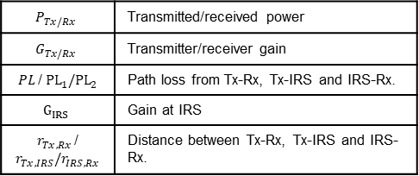



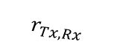


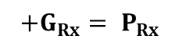


2. Related work: Channel Modeling
$$P_{Tx/Rx}$$ | Transmitted/received power
$$G_{Tx/Rx}$$ | Transmitter/receiver gain
$PL$/${ PL}_{1}/{PL}_{2}$ | Path loss from Tx-Rx, Tx-IRS and IRS-Rx.
$$G_{IRS}$$ | Gain at IRS
$r_{Tx,Rx }$/ $r_{Tx,IRS}/r_{IRS,Rx}$ | Distance between Tx-Rx, Tx-IRS and IRS-Rx.
Aim: To optimize the performance of IRS
Power flow
$$IRS$$
Power flow
$$r_{Tx,IRS}$$
$$r_{IRS,Rx}$$
Tx
$$r_{Tx,Rx}$$
Rx
Tx
Blocked line-of-sight
Rx
Typical communication link
$$P_{Tx}+G_{Tx}− PL+G_{Rx}= P_{Rx}$$
Communication link with IRS
$$P_{Tx}+G_{Tx}$$
$$−{PL}_{1}$$
$$+G_{IRS}$$
$$−{PL}_{2}$$
$$+G_{Rx}= P_{Rx}$$
Notes:
It characterizes the path that a wireless signal travels from Tx to Rx.

Slide 7
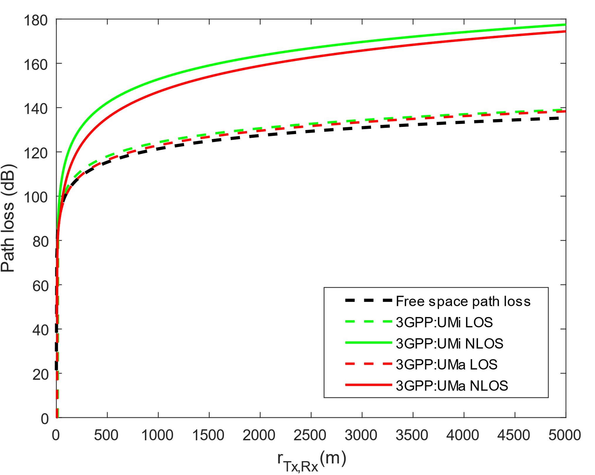
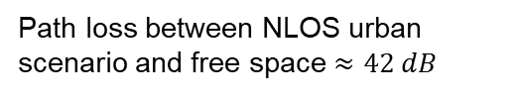
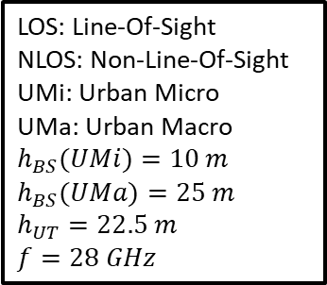
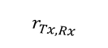

2. Related Work: Propagation Models
Power Flow
$$r_{Tx,Rx}$$
Tx
Rx
Path loss between NLOS urban scenario and free space $≈42 dB$
Path loss between NLOS and LOS urban scenario $≈35 dB$
LOS: Line-Of-Sight
NLOS: Non-Line-Of-Sight
UMi: Urban Micro
UMa: Urban Macro
$$h_{BS}(UMi)=10 m$$
$$h_{BS}(UMa)=25 m$$
$$h_{UT}=22.5 m$$
$$f=28 GHz$$
Fig. 4: Comparison among different path loss models (28 GHz) [5,6].
[5] Aljumaily, Mustafa. (2018). Routing Protocols Performance in Mobile Ad-Hoc Networks Using mmWave. International Journal of Computer Networks and Communications. 10. 23-36. 10.5121/ijcnc.2018.10402
[6] 3rd Generation Partnership Project (3GPP). (2017). Study on channel model for frequencies from 0.5 to 100 GHz (3GPP TR 38.901 version 14.0.0 Release 14)

Slide 8
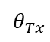
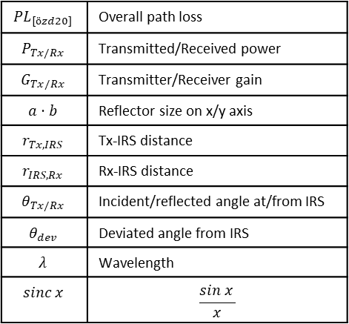
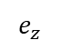
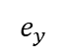
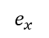
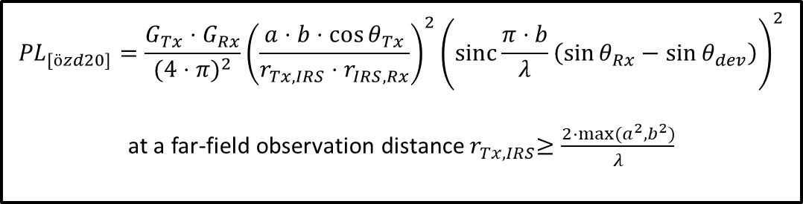
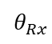
IRS channel model 1 by Özdogan et al. [7]
Incident wave
$$e_{z}$$
Scattered wave
$${PL}_{[özd20]}=\frac{G_{Tx}⋅G_{Rx}}{{(4⋅π)}^{2}}{\left(\frac{a⋅b⋅\cos{θ_{Tx}}}{r_{Tx,IRS}⋅r_{IRS,Rx}}\right)}^{2}{\left(sinc⁡\frac{π⋅b}{λ}\left(\sin{θ_{Rx}}−\sin{θ_{dev}}\right)\right)}^{2}$$
at a far-field observation distance${ r}_{Tx,IRS}≥\frac{2⋅max⁡(a^{2},b^{2})}{λ}$
$$θ_{Tx}$$
$$θ_{Rx}$$
$$e_{y}$$
b
$${PL}_{[özd20]}$$ | Overall path loss
$$P_{Tx/Rx}$$ | Transmitted/Received power
$$G_{Tx/Rx}$$ | Transmitter/Receiver gain
$$a⋅b$$ | Reflector size on x/y axis
$$r_{Tx,IRS}$$ | Tx-IRS distance
$$r_{IRS,Rx}$$ | Rx-IRS distance
$$θ_{Tx/Rx}$$ | Incident/reflected angle at/from IRS
$$θ_{dev}$$ | Deviated angle from IRS
$$λ$$ | Wavelength
$$sinc x$$ | $$\frac{sin x }{x}$$
$$e_{x}$$
a
Fig. 5: Illustration of experimental setup with 2D angles [7].
[7] Ö. Özdogan, E. Björnson and E. G. Larsson, "Intelligent Reflecting Surfaces: Physics, Propagation, and Pathloss Modeling," in IEEE Wireless Communications Letters, vol. 9, no. 5, pp. 581-585, May 2020.
Notes:
. This figure illustrates an incident wave that is scattered by an axb rectangular perfectly conducting plate. The authors from this paper focuses on deriving a far-field path loss equation satisfying the far-field observation distance which satisfies this equation here.
. The goal is to achieve total reflection with its main beam pointing in a desired direction given by theta_dev

Slide 9
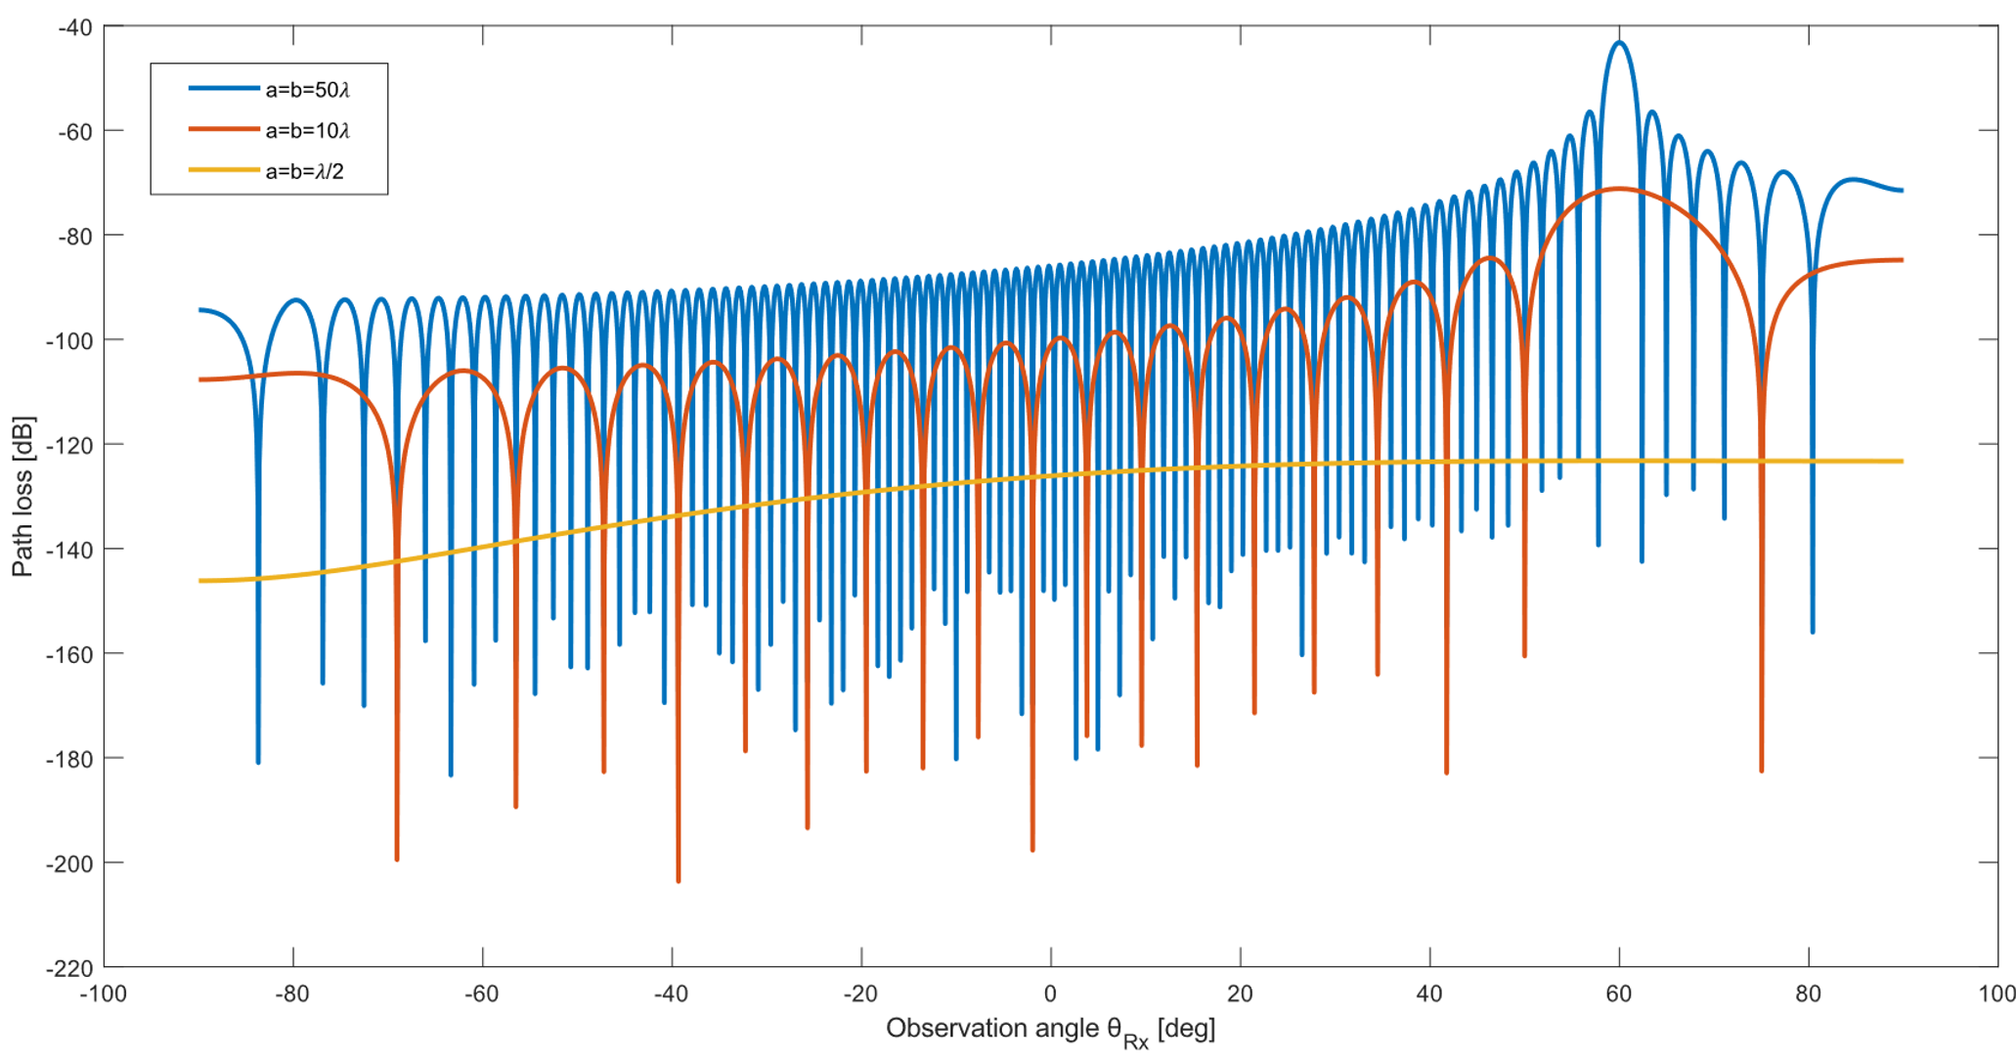
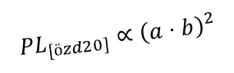

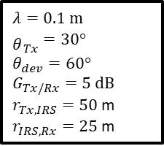
IRS channel model 1 by Özdogan et al. [7]: Results
$λ=0.1$ m
${\begin{aligned} \\ θ\end{aligned}}_{Tx}=30°$
$$θ_{dev}=60°$$
$$G_{Tx/Rx}=5 dB$$
$r_{Tx,IRS}=50$ m
$r_{IRS,Rx}=25$ m
$${PL}_{[özd20]}∝{\left(a⋅b\right)}^{2}$$
Narrow beams with higher gain
$$θ_{dev}=60°$$
Fig. 6: The path loss of reflected path for different IRS sizes[7].
Notes:
When each reflector, $a=b≤λ,$IRS acts as a diffuse scatter almost equally strong in all observation angles.

Slide 10
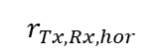
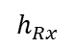
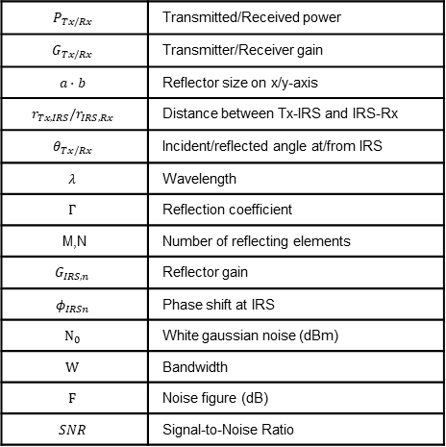

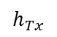
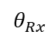
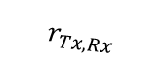
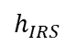

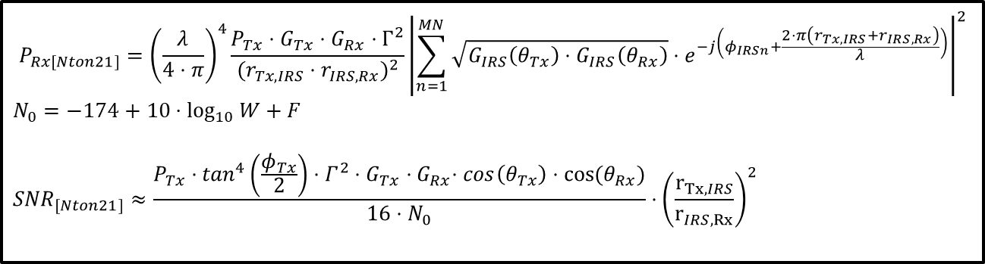

IRS channel model 2 by Ntontin et al. [8]
$$P_{Rx[Nton21]}={\left(\frac{λ}{4⋅π}\right)}^{4}\frac{P_{Tx}⋅G_{Tx}⋅G_{Rx}⋅Γ^{2}}{{(r_{Tx,IRS}⋅r_{IRS,Rx})}^{2}}{\left|\sum_{n=1}^{MN}{\sqrt{G_{IRS}\left(θ_{Tx}\right)⋅G_{IRS}\left(θ_{Rx}\right)}⋅e^{−j\left(φ_{IRSn}+\frac{2⋅π\left(r_{Tx,IRS}+r_{IRS,Rx}\right)}{λ}\right)}}\right|}^{2}$$
$$N_{0}=−174+10⋅\log_{10}{W}+F$$
$${SNR}_{[Nton21]}≈\frac{P_{Tx}⋅\tan^{4}\left(\frac{φ_{Tx}}{2}\right)⋅Γ^{2}⋅G_{Tx}{⋅G}_{Rx}⋅cos\left(θ_{Tx}\right)⋅cos⁡(θ_{Rx})}{16⋅N_{0}}⋅{\left(\frac{r_{Tx,IRS}}{r_{IRS,Rx}}\right)}^{2}$$
IRS
$$r_{Tx,IRS}$$
$$r_{IRS,Rx}$$
$$θ_{Tx}$$
$$θ_{Rx}$$
$$h_{IRS}$$
$$P_{Tx/Rx}$$ | Transmitted/Received power
$$G_{Tx/Rx}$$ | Transmitter/Receiver gain
$$a⋅b$$ | Reflector size on x/y-axis
$$r_{Tx,IRS}/r_{IRS,Rx}$$ | Distance between Tx-IRS and IRS-Rx
$$θ_{Tx/Rx}$$ | Incident/reflected angle at/from IRS
$$λ$$ | Wavelength
$$Γ$$ | Reflection coefficient
M,N | Number of reflecting elements
$$G_{IRS,n}$$ | Reflector gain
$$φ_{IRSn}$$ | Phase shift at IRS
$$N_{0}$$ | White gaussian noise (dBm)
$$W$$ | Bandwidth
$$F$$ | Noise figure (dB)
$$SNR$$ | Signal-to-Noise Ratio
$$r_{Tx,Rx}$$
Tx
Rx
$$h_{Tx}$$
$$h_{Rx}$$
$$r_{Tx,Rx,hor}$$
Fig. 7: Simulation Setup with NLOS condition and 2D angles [8].
[8] K. Ntontin et al., "Optimal Reconfigurable Intelligent Surface Placement in Millimeter-Wave Communications," 2021 15th European Conference on Antennas and Propagation (EuCAP), Dusseldorf, Germany, 2021, pp. 1-5, doi: 10.23919/EuCAP51087.2021.9411076
Notes:
The authors find optimal location for the IRS placement by using SNR equation.

Slide 11

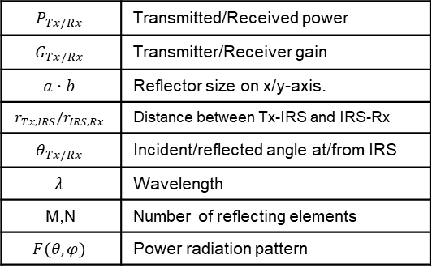

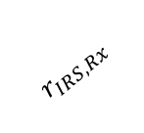
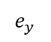
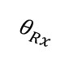
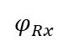
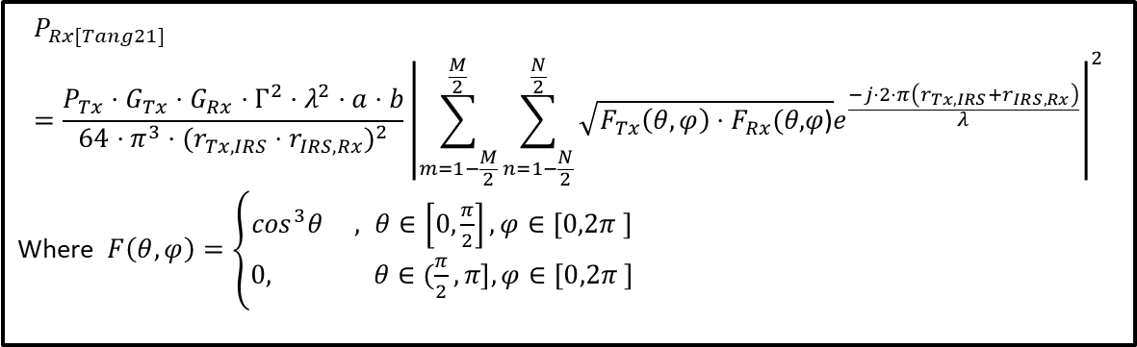
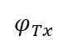
IRS channel model 3 by Tang et al. [9]
Tx
Rx
$$e_{z}$$
$$e_{y}$$
$$r_{IRS,Rx}$$
$$P_{Rx[Tang21]}=\frac{P_{Tx}⋅G_{Tx}⋅G_{Rx}⋅Γ^{2}⋅λ^{2}⋅a⋅b}{64⋅π^{3}⋅{(r_{Tx,IRS}⋅r_{IRS,Rx})}^{2}}{\left|\sum_{m=1−\frac{M}{2}}^{\frac{M}{2}}{\sum_{n=1−\frac{N}{2}}^{\frac{N}{2}}{\sqrt{F_{Tx}\left(θ,φ\right)⋅F_{Rx}(θ\text{,}φ\text{)}}e^{\frac{−j⋅2⋅π\left(r_{Tx,IRS}+r_{IRS,Rx}\right)}{λ}}}}\right|}^{2}$$
Where $F\left(θ,φ\right)=\left\{\begin{aligned}\cos^{3}θ , θ∈\left[0,\frac{π}{2}\right], φ∈\left[0,2π \right] \\ &0, θ∈(\frac{π}{2},π], φ∈\left[0,2π \right]\end{aligned}\right.$
$$r_{Tx,IRS}$$
$$θ_{Tx}$$
$$θ_{Rx}$$
$$φ_{Tx}$$
$$φ_{Rx}$$
$$e_{x}$$
(0,0,0)
b
$$P_{Tx/Rx}$$ | Transmitted/Received power
$$G_{Tx/Rx}$$ | Transmitter/Receiver gain
$$a⋅b$$ | Reflector size on x/y-axis.
$$r_{Tx,IRS}/r_{IRS,Rx}$$ | Distance between Tx-IRS and IRS-Rx
$$θ_{Tx/Rx}$$ | Incident/reflected angle at/from IRS
$$λ$$ | Wavelength
M,N | Number of reflecting elements
$$F(θ,φ)$$ | Power radiation pattern
a
Fig. 8: IRS assisted wireless communication with 3D angles [9].
[9] W. Tang et al., "Wireless Communications With RIS: Path Loss Modeling and Experimental Measurement," in IEEE Transactions on Wireless Communications, vol. 20, no. 1, pp. 421-439, Jan. 2021
Notes:
The authors have developed an IRS-assisted wireless communication for different scenarios with elevation and azimuth angle from the tx and Rx depending on their nature.

Slide 12
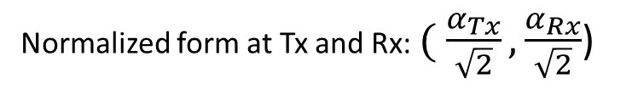

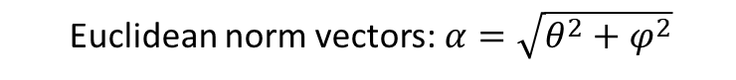
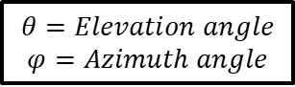

3. Methodology and Implementation:
$$θ=Elevation angle$$
$$φ=Azimuth angle$$
x
Euclidean norm vectors:$α=\sqrt{θ^{2}+φ^{2}}$
$$θ$$
$$φ$$
y
Normalized form at Tx and Rx: $( \frac{α_{Tx}}{\sqrt{2}},\frac{α_{Rx}}{\sqrt{2}}$)
Fig. 9: Illustration of 3D angles with elevation ($θ$) and azimuth ($φ$) angles.
Notes:
We normalize them to keep their magnitudes same.

Slide 13
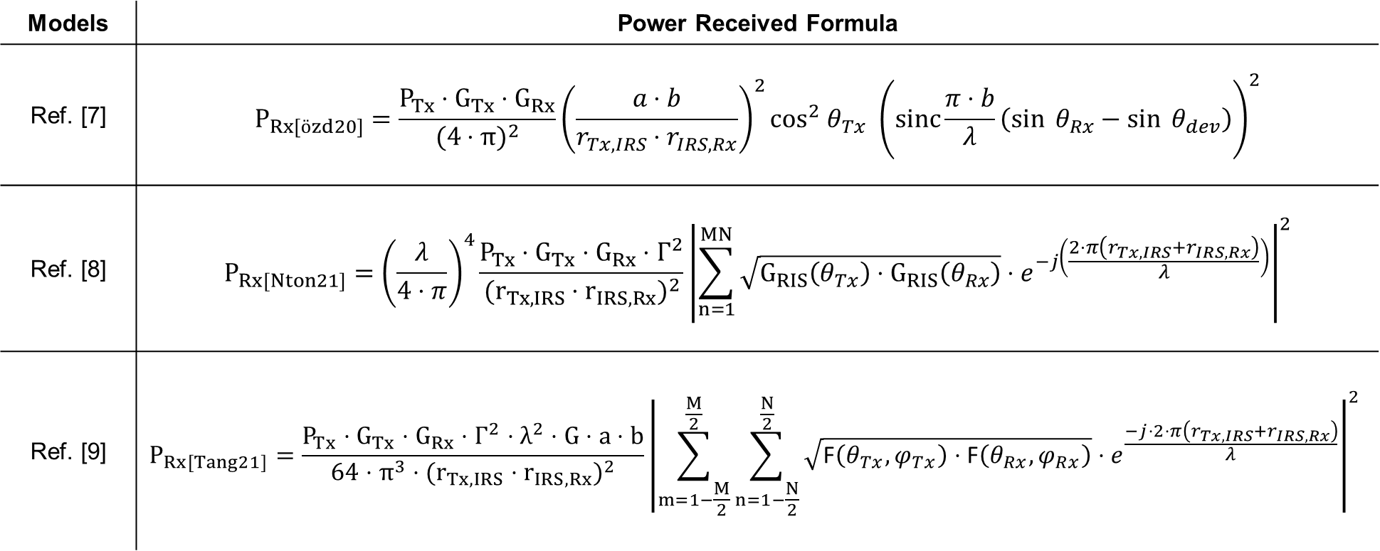


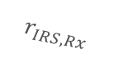
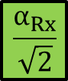
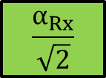
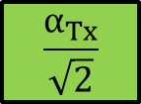
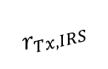
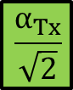
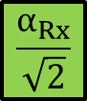
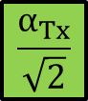
Model [7-9] extension
$$IRS$$
Tx
Rx
$$r_{Tx,IRS}$$
$$r_{IRS,Rx}$$
Models | Power Received Formula
Ref. [7] | $$P_{Rx[özd20]}=\frac{P_{Tx}⋅G_{Tx}⋅G_{Rx}}{{(4⋅π)}^{2}}{\left(\frac{a⋅b}{r_{Tx,IRS}⋅r_{IRS,Rx}}\right)}^{2}\cos^{2} θ_{Tx}{ \left(sinc⁡\frac{π⋅b}{λ}\left(\sin{θ_{Rx}}−\sin{θ_{dev}}\right)\right)}^{2}$$
Ref. [8] | $$P_{Rx[Nton21]}={\left(\frac{λ}{4⋅π}\right)}^{4}\frac{P_{Tx}⋅G_{Tx}⋅G_{Rx}⋅Γ^{2}}{{(r_{Tx,IRS}⋅r_{IRS,Rx})}^{2}}{\left|\sum_{n=1}^{MN}{\sqrt{G_{RIS}\left(θ_{Tx}\right)⋅G_{RIS}\left(θ_{Rx}\right)}⋅e^{−j\left(\frac{2⋅π\left(r_{Tx,IRS}+r_{IRS,Rx}\right)}{λ}\right)}}\right|}^{2}$$
Ref. [9] | $$P_{Rx[Tang21]}=\frac{P_{Tx}⋅G_{Tx}⋅G_{Rx}⋅Γ^{2}⋅λ^{2}⋅G⋅a⋅b}{64⋅π^{3}⋅{(r_{Tx,IRS}⋅r_{IRS,Rx})}^{2}}{\left|\sum_{m=1−\frac{M}{2}}^{\frac{M}{2}}{\sum_{n=1−\frac{N}{2}}^{\frac{N}{2}}{\sqrt{\text{F}\left(θ_{Tx},φ_{Tx}\right)⋅\text{F}\left(θ_{Rx},φ_{Rx}\right)}}}⋅e^{\frac{−j⋅2⋅π\left(r_{Tx,IRS}+r_{IRS,Rx}\right)}{λ}}\right|}^{2}$$
$$\frac{α_{Tx}}{\sqrt{2}}$$
$$\frac{α_{Rx}}{\sqrt{2}}$$
$$\frac{α_{dev}}{\sqrt{2}}$$
$$\frac{α_{Tx}}{\sqrt{2}}$$
$$\frac{α_{Rx}}{\sqrt{2}}$$
$$\frac{α_{Tx}}{\sqrt{2}}$$
$$\frac{α_{Rx}}{\sqrt{2}}$$

Slide 14
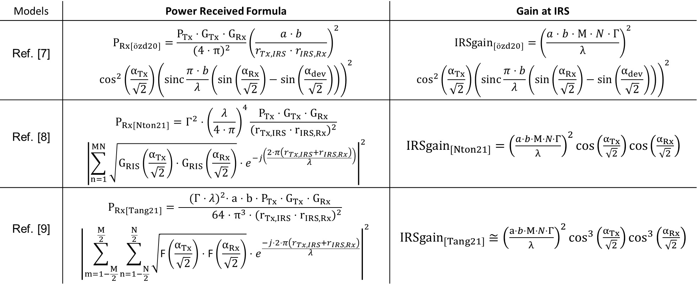
Model Extension
$$IRS$$
Tx
Rx
$$r_{Tx,IRS}$$
$$r_{IRS,Rx}$$
Models | Power Received Formula | Gain at IRS
Ref. [7] | $$P_{Rx[özd20]}=\frac{P_{Tx}⋅G_{Tx}⋅G_{Rx}}{{(4⋅π)}^{2}}{\left(\frac{a⋅b}{r_{Tx,IRS}⋅r_{IRS,Rx}}\right)}^{2}$$ $$\cos^{2}\left(\frac{α_{Tx}}{\sqrt{2}}\right){\left(sinc⁡\frac{π⋅b}{λ}\left(\sin\left(\frac{α_{Rx}}{\sqrt{2}}\right)−\sin\left(\frac{α_{dev}}{\sqrt{2}}\right)\right)\right)}^{2}$$ | $${IRSgain}_{[özd20]}={\left(\frac{a⋅b⋅M⋅N⋅Γ}{λ}\right)}^{2}$$ $$\cos^{2}\left(\frac{α_{Tx}}{\sqrt{2}}\right){\left(sinc⁡\frac{π⋅b}{λ}\left(\sin\left(\frac{α_{Rx}}{\sqrt{2}}\right)−\sin\left(\frac{α_{dev}}{\sqrt{2}}\right)\right)\right)}^{2}$$
Ref. [8] | $$P_{Rx[Nton21]}={Γ^{2}⋅\left(\frac{λ}{4⋅π}\right)}^{4}\frac{P_{Tx}⋅G_{Tx}⋅G_{Rx}}{{(r_{Tx,IRS}⋅r_{IRS,Rx})}^{2}}$$ $${\left|\sum_{n=1}^{MN}{\sqrt{G_{RIS}\left(\frac{α_{Tx}}{\sqrt{2}}\right)⋅G_{RIS}\left(\frac{α_{Rx}}{\sqrt{2}}\right)}⋅e^{−j\left(\frac{2⋅π\left(r_{Tx,IRS}+r_{IRS,Rx}\right)}{λ}\right)}}\right|}^{2}$$ | ${IRSgain}_{[Nton21]}={\left(\frac{a⋅b⋅M⋅N⋅Γ}{λ}\right)}^{2}cos\left(\frac{α_{Tx}}{\sqrt{2}}\right)cos\left(\frac{α_{Rx}}{\sqrt{2}}\right)$
Ref. [9] | $$P_{Rx[Tang21]}=\frac{{(Γ⋅λ)}^{2}⋅a⋅b⋅P_{Tx}⋅G_{Tx}⋅G_{Rx}}{ 64⋅π^{3}⋅{(r_{Tx,IRS}⋅r_{IRS,Rx})}^{2}}$$ $${\left|\sum_{m=1−\frac{M}{2}}^{\frac{M}{2}}{\sum_{n=1−\frac{N}{2}}^{\frac{N}{2}}{\sqrt{\text{F}\left(\frac{α_{Tx}}{\sqrt{2}}\right)⋅\text{F}\left(\frac{α_{Rx}}{\sqrt{2}}\right)}}}⋅e^{\frac{−j⋅2⋅π\left(r_{Tx,IRS}+r_{IRS,Rx}\right)}{λ}}\right|}^{2}$$ | ${IRSgain}_{[Tang21]}≅{\left(\frac{a⋅b⋅M⋅N⋅Γ}{λ}\right)}^{2}\cos^{3}\left(\frac{α_{Tx}}{\sqrt{2}}\right)\cos^{3}\left(\frac{α_{Rx}}{\sqrt{2}}\right)$
Notes:
. the factors that influence the gain at IRS include the dimensions and size of the reflector, reflection coefficient of material used and incident and reflected angle at the reflectors and ofcourse freq of operation.

Slide 15
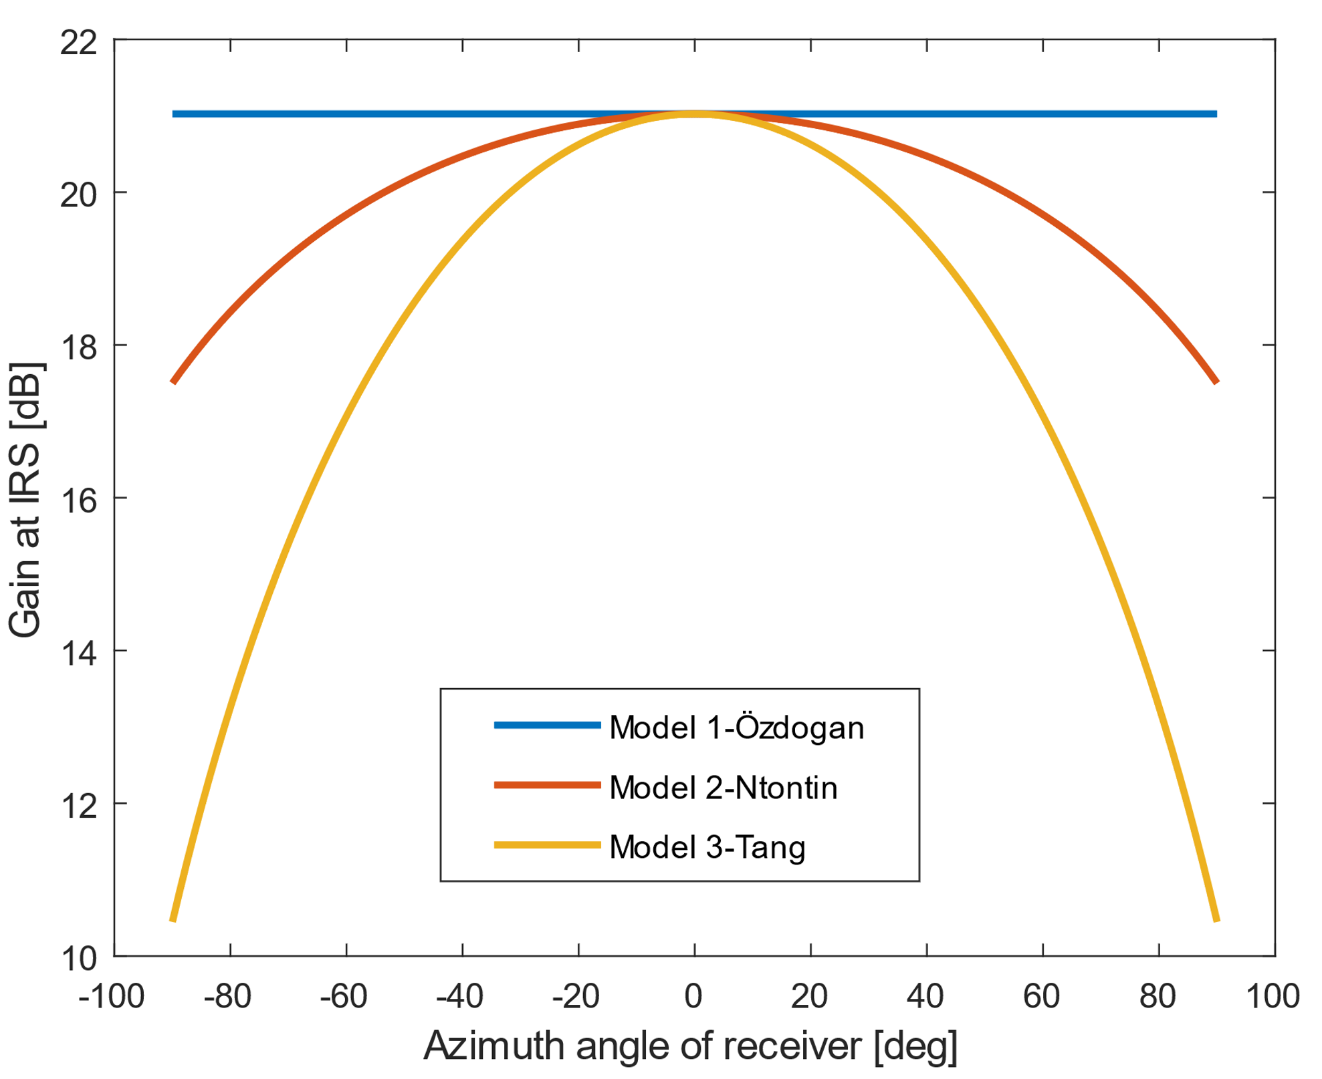
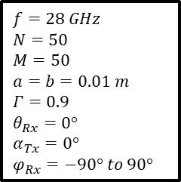
Comparison of 3 models
$$f=28 GHz$$
$$N=50$$
$$M=50$$
$$a=b=0.01 m$$
$$Γ=0.9$$
$$θ_{Rx}=0°$$
$$α_{Tx}=0°$$
$$φ_{Rx}=−90° to 90°$$
Maximum gain when Tx/Rx orthogonal to the reflector surface.
Difference in gain by approx 3.5 dB
Loss of gain when reflector focuses away from surface normal
Difference in gain by approx 10.5 dB
Fig. 10: Comparison among all 3 models at 28GHz with 3D angles [7,8,9].

Slide 16
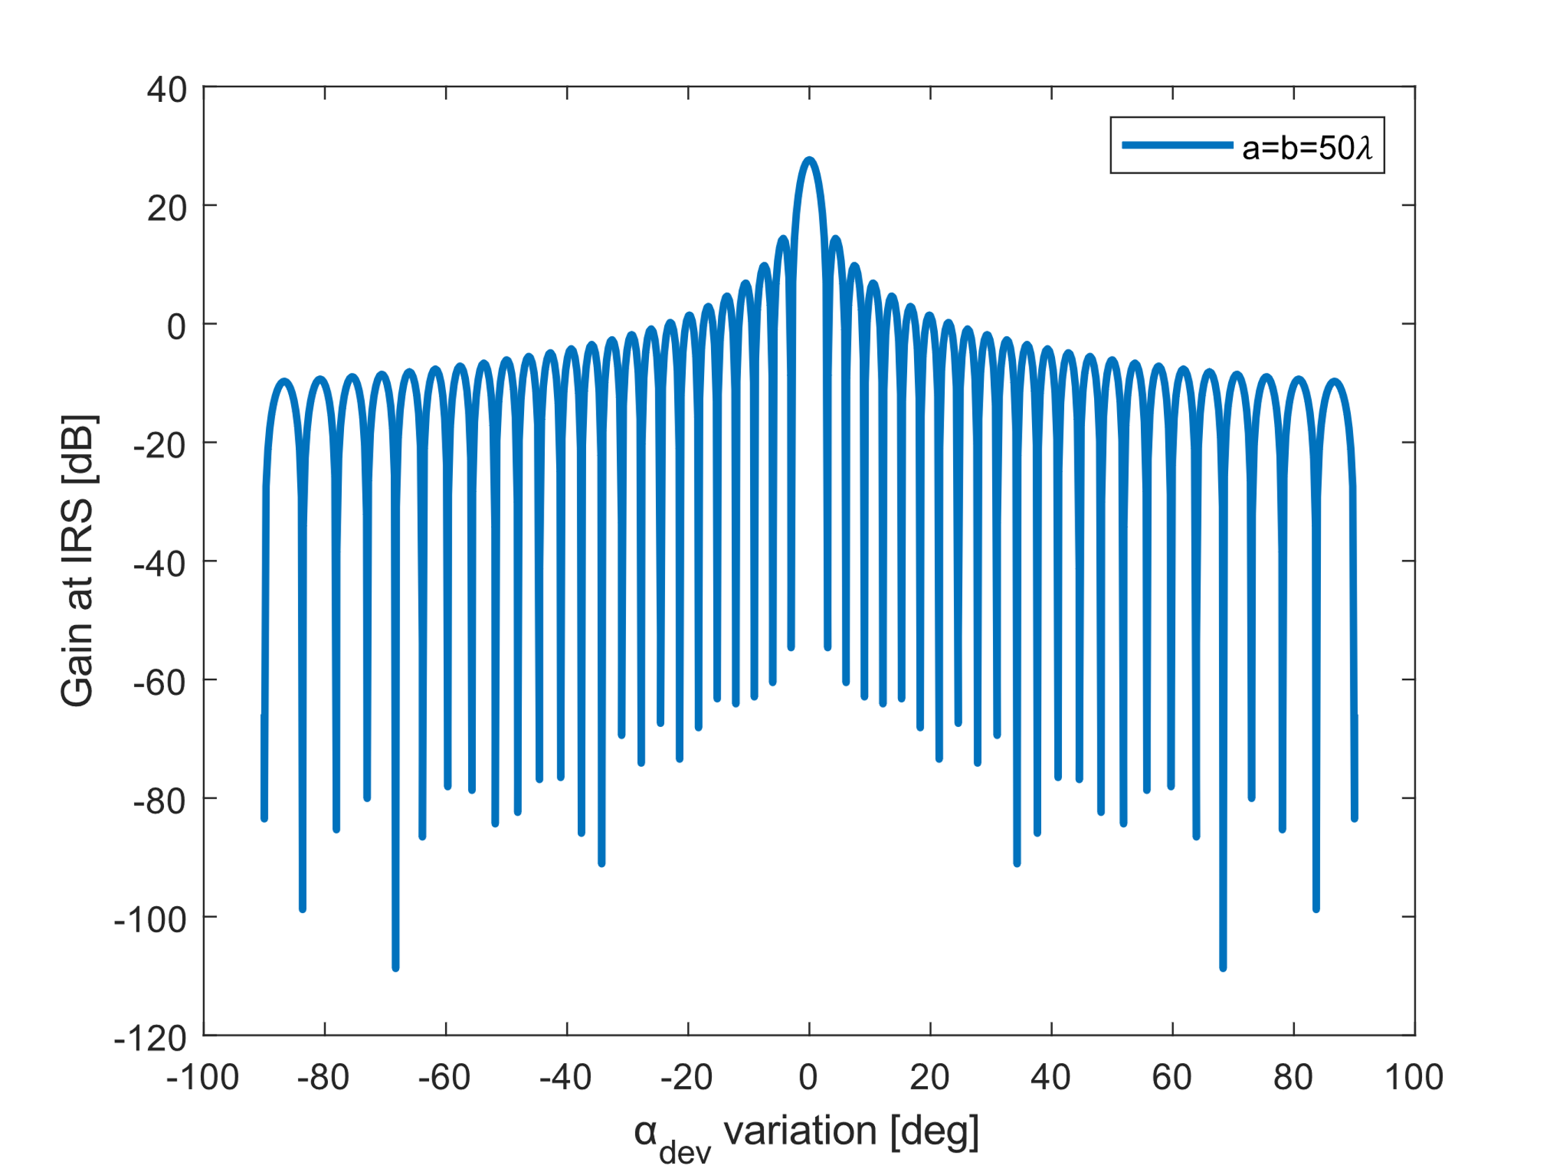







Parameter dependencies of existing IRS models
Angle sweep along UE i.e., $α_{Rx}≠α_{dev}$
UE is at angle where IRS is pointing at i.e., $α_{Rx}=α_{dev}$
Rx location
Models | $$α_{Tx}$$ | $$a⋅b$$ | $$λ$$ | $$α_{Rx}$$ | $$Γ$$ | M$⋅N$ | Support to radiation pattern
Ref. [7] | $$\cos^{2}\left(\frac{α_{Tx}}{\sqrt{2}}\right)$$ | $${(a∙b) }^{2}$$ | $$\frac{1}{{λ }^{2}}$$ | Const. | $$Γ^{2}$$ | $${(M∙N) }^{2}$$ | Yes
Ref. [8] | $$cos\left(\frac{α_{Tx}}{\sqrt{2}}\right)$$ | $${(a∙b) }^{2}$$ | $$\frac{1}{{λ }^{2}}$$ | $$cos⁡(\frac{α_{Rx}}{\sqrt{2}}\text{)}$$ | $$Γ^{2}$$ | $${(M∙N) }^{2}$$ | No
Ref. [9] | $$\cos^{3}\left(\frac{α_{Tx}}{\sqrt{2}}\right)$$ | $${(a∙b) }^{2}$$ | $$\frac{1}{{λ }^{2}}$$ | $$\cos^{3}\left(\frac{α_{Rx}}{\sqrt{2}}\right)$$ | $$Γ^{2}$$ | $${(M∙N) }^{2}$$ | No
$$a⋅b$$
$$λ$$
$$Γ$$
$$\text{M}⋅N$$

Slide 17













Holistic Enlightening of bLackspots with passIve reflectOr moduleS (HELIOS) [10]
$$φ_{out}=−φ_{in}+2γ$$
Key intakes:
Geometry fixes reflection characteristics in contrast to dynamic IRS
Easy installation
Low protrusion (Similar to IRSs)
No power supply
$$φ_{out}=−φ_{in}$$
Wall surface
normal
Incident wave $φ_{in}$
$$\left(θ,φ\right)=(33.1°,0°)$$
Reflector surface
normal
$$\left(θ,φ\right)=(33.1°,0°)$$
$$φ_{out}=−φ_{in}$$
Wall surface
normal
Incident wave $φ_{in}$
$$\left(θ,φ\right)=(33.1°,0°)$$
$$\left(θ,φ\right)=(33.1°,0°)$$
$$2γ$$
$$γ$$
b
Rectangular plate
h
a
$$γ=0°$$
$$h=a⋅tan⁡(γ)$$
$$a=\frac{IRSlength}{N}$$
$$b=IRSlength$$
N= # of reflector element
$γ$=slope angle
$φ_{in}$= Incident phase
$φ_{out}$=Reflected phase
$$γ$$
a
a
Fig. 11: 3D printed and spray painted array of HELIOS model depending on slope angle $γ>0°$ [11].
[10] S. Häger, K. Heimann, S. Böcker and C. Wietfeld, "Holistic Enlightening of Blackspots With Passive Tailorable Reflecting Surfaces for Efficient Urban mmWave Networks," in IEEE Access, vol. 11, pp. 39318-39332, 2023, doi: 10.1109/ACCESS.2023.3267676.

Slide 18




















HFSS Model Simulations
$$a=\frac{IRSlength}{N}$$
$$b=IRSlength$$
$$h=a⋅tan⁡(γ)$$
Scenario: Tx orthogonal to reflector module base.
Materials:
Copper
Pec
Tantalum
Glass
FR4
Incident wave $φ_{in}$
HFSS simulation results for N=1:
Slope angle $γ$ varies from $(0°−80°)$.
IRS length varies from $(1−90 cm)$.
$$γ$$
x
x
x
1
$$h$$
2
x
3
4
x
y
$$γ$$
$$b$$
$$γ$$
$$h$$
$$h$$
$$a$$
$$γ$$
$$γ$$
$$h$$
z
$$h$$
$$b$$
y
$$b$$
y
y
$$γ$$
y
$$γ$$
$$b$$
$$γ$$
$$b$$
$$a$$
$$a$$
z
$$a$$
$$a$$
z
z
z
Fig. 12: HFSS model for 4 different orientations

Slide 19




4. Results and Conclusion: HFSS Simulation on Reflector Size Variation
Double the IRS length
$⇒$ gains up by $≈12 dB$
$$R_{Gain}∝{\left(IRS length\right)}^{4}$$
13(b)
Similar to IRS model [7-9] predicts i.e., ${(a∙b) }^{2}$
13(a)
Fig. 13: HFSS simulations for 4 different orientations for varying IRS lengths (a) Log scale (b) Linear scale.
Notes:
Linear regression

Slide 20



4. Results and Conclusion: HFSS Simulation on Reflector Size Variation
$$a=\frac{IRSlength}{N}$$
$$b=IRSlength$$
$$h=a⋅tan⁡(γ)$$
Double the IRS length$⇒$ gains up by approx $12 dB$ $⇒$ 16 times more power
Narrow beams with higher gain
Fig. 14: Azimuth angle variation for HFSS models for different IRS lengths when $γ$is set to $22.5°$.
Notes:
similar to how antenna array behaves

Slide 21








4. Results and Conclusion: HFSS Simulation on $φ_{out}$ Validation
Saturation beyond $45°(2γ$= $90°$) , as the main lobes is out-of-range of the considered far field
$$γ<45°$$
$$γ$$
Transmitter
$$γ$$
Validating $φ_{out}=−φ_{in}+2γ$
when $φ_{in}$= $0°$
Receiver
$$γ>45°$$
$$γ$$
Transmitter
Receiver
Fig. 15: $φ_{out}$ variation of model simulation when plotted against slope angle $γ$[11].
[11] S. Häger, K. Heimann, S. Böcker and C. Wietfeld, "Holistic Enlightening of Blackspots With Passive Tailorable Reflecting Surfaces for Efficient Urban mmWave Networks," in IEEE Access, vol. 11, pp. 39318-39332, 2023, doi: 10.1109/ACCESS.2023.3267676.
Notes:
With the introduction of HELIOS module, we discussed that reflected wave shifts by 2 times slope angle. Lets see how it behaves for all 4 orientations.

Slide 22


4. Results and Conclusion: HFSS Simulation on Material Influence
Materials | Conductivity (Siemens/m) | Relative permittivity
Copper | 58,000,000 | 1
Pec | 1e+30 | 1
Tantalum | 6,300,000 | 1
FR4 | 0 | 4.4
Glass | 0 | 5.5
Steel | 1,100,000 | 1
$$Gain ∝{Conductivity}^{n}$$
Where exponent n=1.05
Fig. 16: HFSS simulations for varying conductivity of copper materials.
Fig. 17: Gain variation for HFSS models for different materials.
Notes:
Materials with high conductivity has strong absorption and high attenuation of EM waves

Slide 23











Analytical Modeling of HELIOS Reflector: Radar-Cross-Section (RCS) [11]
Tx & Rx
$$Monostatic RCS\text{ (}θ_{Rx}\text{= }θ_{Tx}.{ φ}_{Rx}=\frac{3⋅π}{2})$$
$$σ_{3−D}=4⋅π⋅{\left(\frac{a⋅b}{λ}\right)}^{2}\cos^{2}θ_{Tx}{\left(sinc\left(\frac{2⋅π⋅b⋅sinθ_{Tx}}{λ}\right)\right)}^{2}$$
$$\text{for} 0≤θ_{Tx}≤\frac{π}{2}$$
$$E_{Tx}$$
z
Rx
Tx
z
$$E_{Rx},H_{Rx}$$
$$H_{Tx}$$
$${ φ}_{Rx}=\frac{3⋅π}{2}$$
$$θ_{Tx}$$
$$θ_{Rx}$$
$$φ_{Tx}$$
a
$Bistatic RCS$ (${ φ}_{Rx}=\frac{π}{2}$, $\frac{3⋅π}{2}$)
$$σ_{3−D}=4⋅π⋅{\left(\frac{a⋅b}{λ}\right)}^{2}\cos^{2}θ_{Rx}{\left(sinc\left(\frac{π⋅b⋅(sinθ_{Rx}⋅sinφ_{Rx}−sinθ_{Tx})}{λ}\right)\right)}^{2}$$
for $0≤θ_{Rx}≤\frac{π}{2}$
a
y
y
$$φ_{Rx}$$
$$σ_{3−D}$$ | Radar-Cross-Section 3-D scatter
$$E_{Tx/Rx}$$ | Electric field at transmitter/receiver
$$H_{Tx/Rx}$$ | Magnetic field at transmitter/receiver
$$a⋅b$$ | Reflector size on x/y axis
$$θ_{Tx/Rx}$$ | Tx/Rx elevation angle at/from IRS
$$φ_{Tx/Rx}$$ | Tx/Rx azimuth angle at/from IRS
$$λ$$ | Wavelength
$$sinc x$$ | $$\frac{sin x }{x}$$
b
b
x
x
Fig. 18: Uniform plane wave incident on a rectangular conducting plate [11].
[11] C. A. Balanis, Antenna Theory: Analysis and Design, 3rd edition, Wiley, New York, 2005
Notes:
Radar-Cross-Section which quantifies the amount of radar energy that is scattered back towards the radar system when the object is illuminated by a radar signal.

Slide 24




4. Results and Conclusion: HFSS Simulation on $γ$ Variation
$σ_{3−D}(θ_{Tx}$, $θ_{Rx}$, $φ_{Tx}$, $φ_{Rx}$)
$σ_{3−D}(θ_{Tx}$, ($θ_{Rx}−2⋅γ$), $φ_{Tx}$, $φ_{Rx}$)
Shifted gains as there is a systematic error from the simulations
19(a)
19(b)
Fig. 19: Azimuth angle variation for HFSS models for different $γ$angles when $φ_{in}$= $0°$
(a) HELIOS model simulation (b) Analytical bistatic RCS solution.
Notes:
Somethings are not solved yet, like the behavior of this region here. But we are getting there to solve

Slide 25
















4. Results and Conclusion:
$$σ_{3−D}$$ | Radar-Cross-Section 3-D scatter
$$a⋅b$$ | Reflector size on x/y axis
$$θ_{Tx/Rx}$$ | Tx/Rx elevation angle at/from IRS
$$φ_{Tx/Rx}$$ | Tx/Rx azimuth angle at/from IRS
$$Γ$$ | Material conductivty
$$R_{Gain}∝{\left(a⋅b\right)}^{2}$$
HELIOS simulation
RCS analytical model
$$R_{Gain}∝Γ$$
$$R_{Gain}∝σ_{3−D}(θ_{Tx}\text{,}\text{ (}θ_{Rx}−2⋅γ\text{),} φ_{Tx}\text{,} φ_{Rx}\text{)}$$
$$γ$$
$$γ$$
$$γ$$
$$γ$$
$$γ_{1}$$
$$γ$$
$$R_{Gain}∝{\left(a⋅b\right)}^{2}⋅Γ⋅σ_{3−D}(θ_{Tx}\text{,}\text{ (}θ_{Rx}−2⋅γ\text{),} φ_{Tx}\text{,} φ_{Rx}\text{)}$$
$$γ$$
$$γ$$
$$γ$$
$$γ$$
$$γ$$
$$γ_{2}$$
# reflecting elements | RCS analytical model
$$M,N=1$$ | $$σ_{3−D}(θ_{Tx}\text{,}\text{ (}θ_{Rx}−2⋅γ\text{),} φ_{Tx}\text{,} φ_{Rx}\text{)}$$
$$M,N>1$$ | $$\sum_{n=1}^{MN}{σ_{3−D}(θ_{Tx}\text{,}\text{ (}θ_{Rx}−2⋅γ\text{),} φ_{Tx}\text{,} φ_{Rx}\text{)}}$$
Future work

Slide 26
5. Timeline
Stage 1
Literature reading
Stage 2
Stage 3
Implementation, Reinterpretation of IRS models
Stage 4
Familiarization with a thesis template
Preparation of kickoff presentation
HELIOS simulation with Ansys HFSS
Helios array simulation and modeling
Working on thesis section 3
Preparation of the second presentation
Optimizing and evaluating HELIOS model according to design requirement
Working on thesis section 4
Preparation of the third presentation
Working on the thesis’s final section
Preparation of the final presentation
Radar Cross Section (RCS) for planar surface
Comparing analytical and Ansys simulation
Tuning of analytical model

Slide 27
Thank you!

